Slide 1
Operationalizing a Curriculum in Human Flourishing: A Skill Building Workshop
2025 International Congress on Integrative Medicine and Health
Aviad Haramati, PhD Kimara Ellefson, MBA Professor of Integrative Physiology and Medicine National Director of Strategy and Partnerships
Director, Center for Innovation and Leadership Kern National Network for Flourishing in Medicine
in Education (CENTILE) Medical College of Wisconsin Georgetown University Medical Center Milwaukee, WI, USA
Washington, DC, USA

Slide 2
Introductions and Goals

Slide 3
Think about a time you observed or experienced flourishing:
What does flourishing look or feel like to you?
What is something that symbolizes flourishing to you?

Slide 4
Flourishing as Defined in KNN Framework Flourishing refers to a wholeness—of being and doing, of realizing one’s potential and helping others do the same.¹ It can be measured across domains of:
Happiness and life satisfaction
Physical and mental health
Meaning and purpose
Character and virtue
Relationships
It is most commonly achieved through pathways of family, work, education and spiritual community.² 1. Su, F (2020)
2. VanderWeele, TJ (2017)
Rev. 8/24
Notes:
In the KNN word we are defining flourishing as “A wholeness – of being and doing, of realizing one’s potential and helping others do the same”
May wonder: how is this different than wellness or well-being efforts?

Slide 5
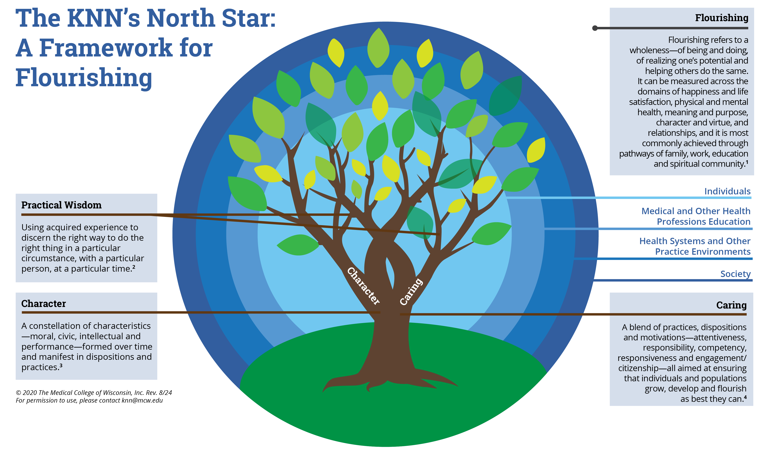

Slide 6
Character
A constellation of characteristics— moral, civic, intellectual and performance—formed over time and manifest in dispositions and practices.³

Slide 7
Cultivating the Building Blocks of Character
Intellectual Virtues
Moral Virtues
Civic Virtues
Performance Virtues
Character traits necessary for discernment, right action and the pursuit of knowledge, truth and understanding.
Character traits that enable us to act well in situations that require an ethical response.
Character traits that are necessary for engaged responsible citizenship, contributing to the common good.
Character traits that have an instrumental value in enabling the intellectual, moral and civic virtues.
Examples:
autonomy; critical thinking; curiosity; judgement; reasoning; reflection; resourcefulness.
Examples: compassion; courage; gratitude; honesty; humility; integrity; justice; respect.
Examples: citizenship; civility; community awareness; neighbourliness; service; volunteering.
Examples: confidence; determination; motivation; perseverance; resilience; leadership; teamwork.
Practical Wisdom (phronesis) is the integrative virtue, developed through experience and critical reflection, which enables us to perceive, know, desire and act with good sense. This includes discerning, deliberative action in situations where virtues collide.
Flourishing individuals and society
Source: Jubilee Centre for Character and Virtues (2022). Jubilee Centre Framework for Character Education in Schools. Third Edition.

Slide 8
Practical Wisdom
Using acquired experience to discern the right way to do the right thing in a particular circumstance, with a particular person, at a particular time. ²

Slide 9
Using Practical Wisdom to Navigate Complexity
Deliberating and discerning the best path forward in a particular situation
Continually developed through experience, reflection and integration
Place and power of narratives

Slide 10
Caring
A blend of practices, dispositions and motivations—attentiveness, responsibility, competency, responsiveness and engagement/citizenship—all aimed at ensuring that individuals and populations grow, develop and flourish as best they can. ⁴

Slide 11
If caring is an essential part of reaching our full human potential…
Our Democracy
Our Communities
Our Institutions
Individuals
…what is the scope of our caring responsibilities?

Slide 13
Self-care Needs (for faculty, students, staff and even deans)
Physiological self-care for the Body
reducing the effects of stress on functions of the body
Psychological self-care for the Mind
reducing the impact of stress on our psyche/emotions
Spiritual self-care for the Soul
finding meaning in our lives

Slide 14
Mind-Body Medicine Program at Georgetown U School of Medicine (2002)
Goal
To increase student understanding of self-awareness and self-care by providing a unique experiential and didactic introduction to Mind-Body Medicine

Slide 15
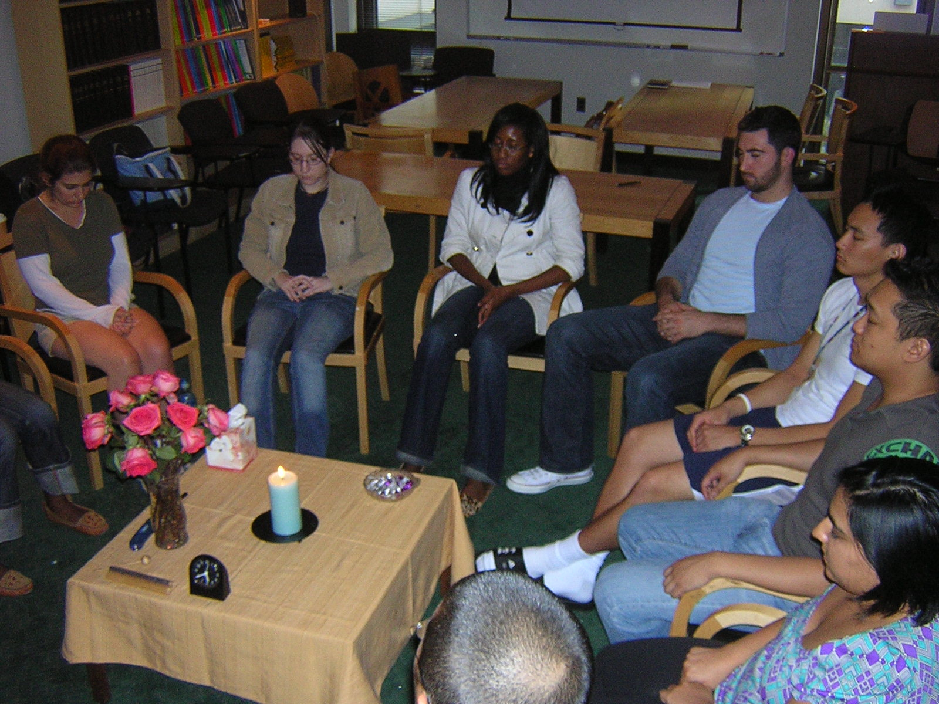
Mind-Body Skills Course at Georgetown University SOM
11-week course uses mind-body techniques to foster self-awareness and self-care
Week 1 Introduction & Drawings I
Week 2 Autogenic Training/ Biofeedback
Week 3 Meditation:
Eating
Sitting
Week 4
Walking Meditation
Week 5
Guided
Imagery I
Week 6
Guided
Imagery II
Week 7
Movement Meditation
Week 8
Journaling:
Dialogue with a Symptom
Week 9
Forgiveness Meditation
Week 10
Drawings II
Week 11
Positive
Quality
Cards and
Closing Ritual

Slide 16
Mind-Body Medicine Program at Georgetown U School of Medicine
Outcomes
Perceived Stress (Perceived Stress Scale)
Mindfulness (Freiburg Mindfulness Inventory)
Empathy (Interpersonal Reactivity Index)

Slide 17
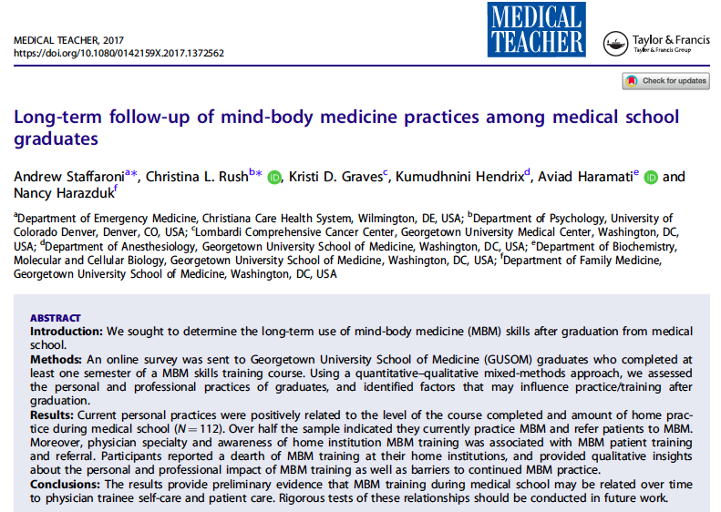
Preliminary evidence suggests that MBM training during medical school has a long-term positive impact on physicians during residency and practice in terms of their self-care and how they approach patient care.

Slide 18
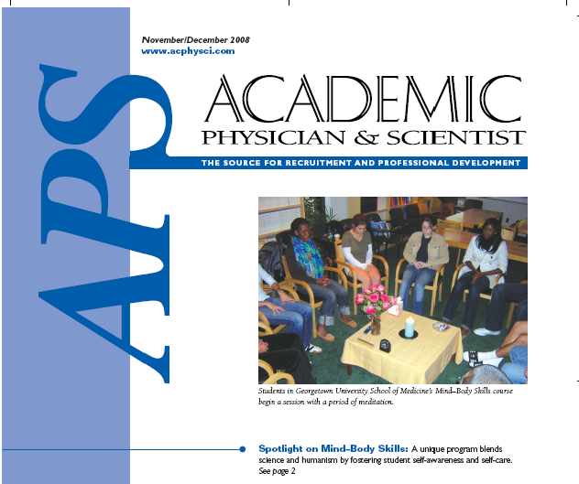
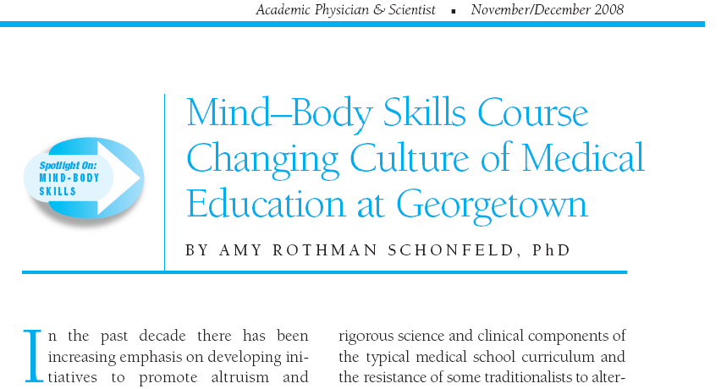

Slide 20
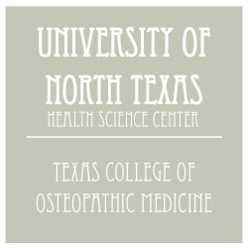
More Medical & Health Professions Schools are Teaching Students Mind-Body Medicine Skills
Georgetown University School of Medicine (medical students, residents, Faculty, Law School)
University of Cincinnati (medicine, allied health, nursing, pharmacy, CCM, DAAP, Law, Arts & Sciences, students, residents, faculty, staff)
Wake Forest University School of Medicine (medical students and faculty)
University of Alabama at Birmingham (medical students)
University of Louisville School of Medicine (medical students)
University of Florida (medical students, pharmacy, faculty)
Indiana University School of Medicine (medical students)
University of Vermont (medical students)
University of North Dakota Medical School (medical students)
Charite University Medical School, Germany (medical students)
University of Essen-Duisenberg Medical School, Germany (medical students)
University of Friburg, Switzerland (medical students)
University of Lausane, Switzerland (medical students)
University of Utrecht, Netherlands (medical students)
Texas College of Osteopathic Medicine (medical students)
Stanford University, Anesthesia Residency Program
University of Western States (chiropractic and other CAM professions)
Mid-Sweden University, Sweden (nursing students)

Slide 21
As Faculty: we are very hard on ourselves
We too suffer from Imposter Syndrome
We try hard to ‘balance’ our responsibilities (impossibly) (educator, scholar, practitioner, role model, etc)
We attempt to juggle ‘professional’ and ‘personal’ aspects of our lives
Mostly, we rarely exercise self-compassion
It is time for us to take care of ourselves

Slide 22
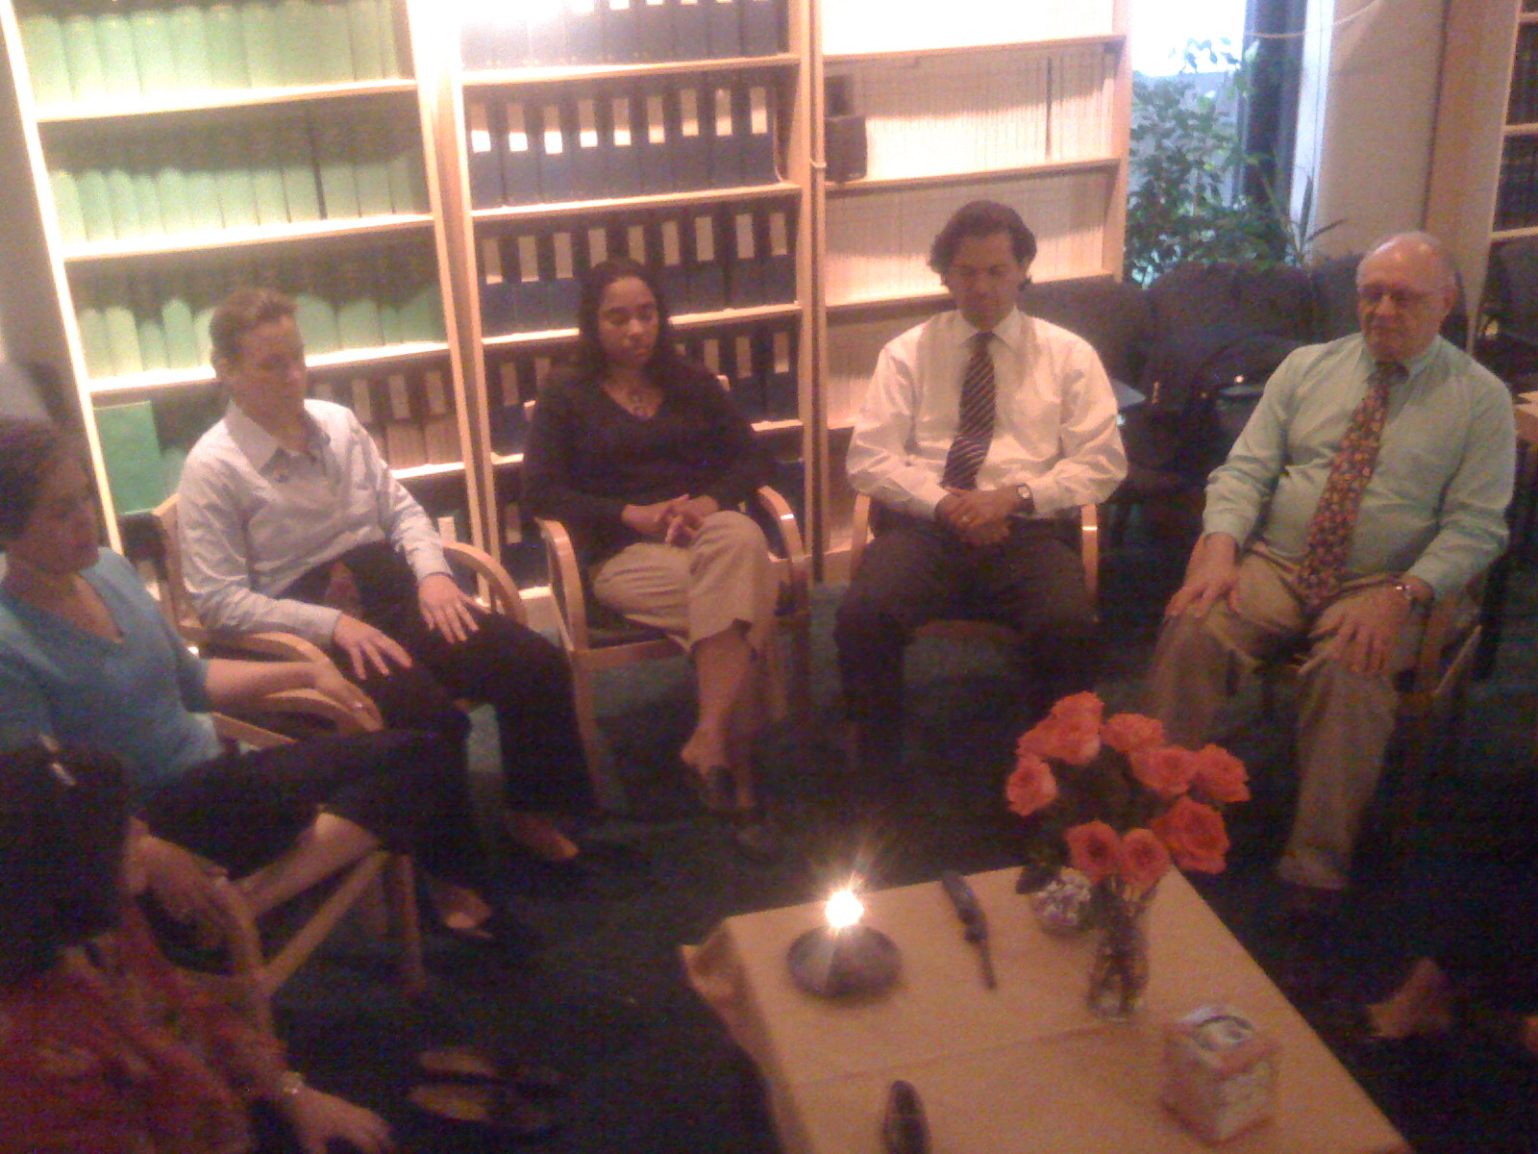

Slide 23
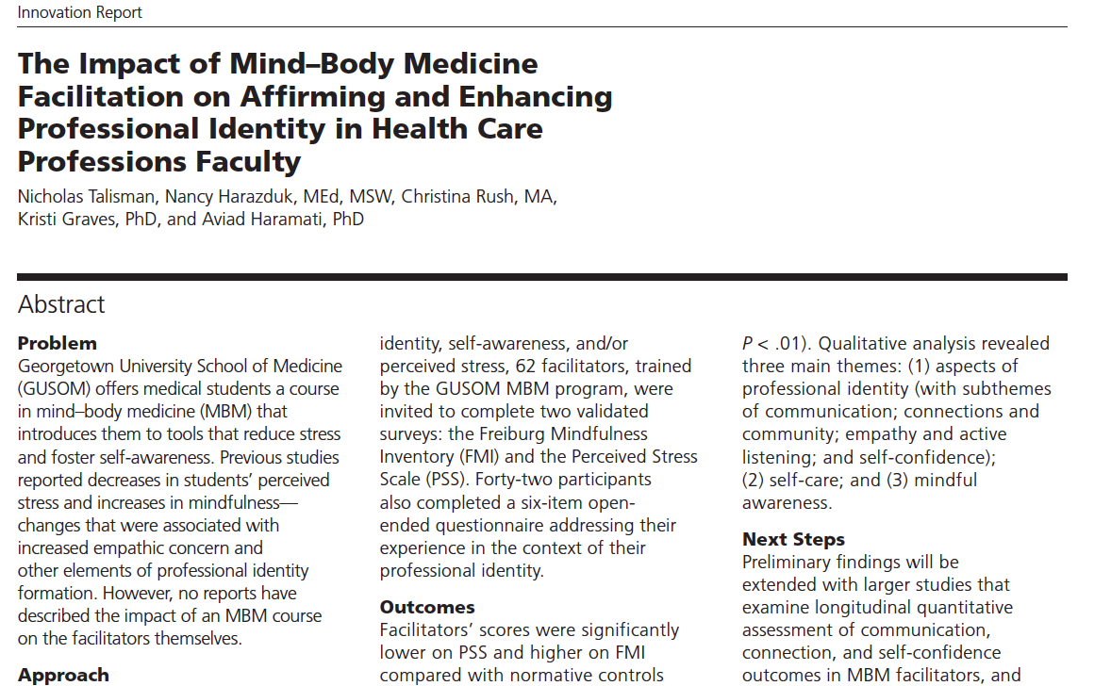
Acad Med 90:780-784, June 2015
Facilitators’ scores were significantly lower on perceived stress and higher on mindfulness, and were significantly correlated.
Qualitative analysis revealed…improvements in communication between colleagues, increased sense of connection with students and colleagues, increased empathy, and heightened self-confidence.

Slide 24
New Insight
When faculty and senior staff serve as facilitators of mind-body groups, they help learners (students and residents) and also help themselves.

Slide 25
What was lacking?
Faculty colleagues were not thriving
Students were still trying to recover from the pandemic
For various reasons, majority of the class did not sign up for the mind-body course
We should be doing more to help students, faculty and staff thrive!

Slide 26
To help medical students and faculty thrive in medical school and in life…
…we decided to develop a new course for first year students that incorporates various domains of
Human Flourishing

Slide 27
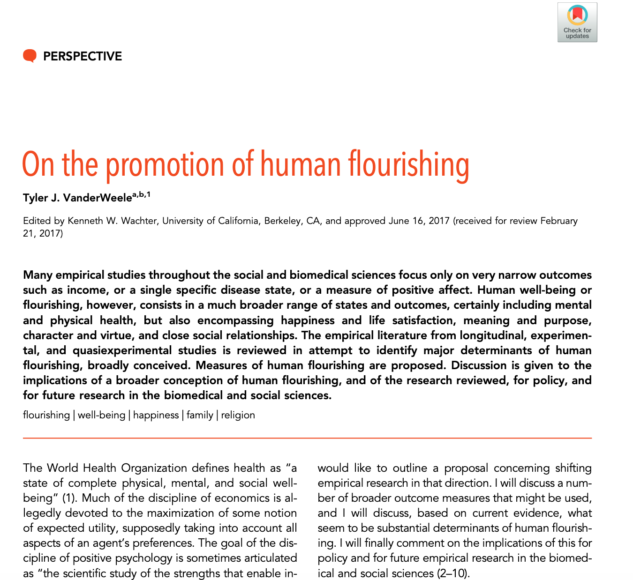
What is meant by Human Flourishing?
Proc Nat Acad Sci USA, 114: 8148–8156 2017
Well-being in humans is certainly dependent on physical and mental health, but also consists of a broader range of states and outcomes, such as:
Happiness and life satisfaction
Meaning and purpose
Character and virtue
Close social relationships

Slide 28
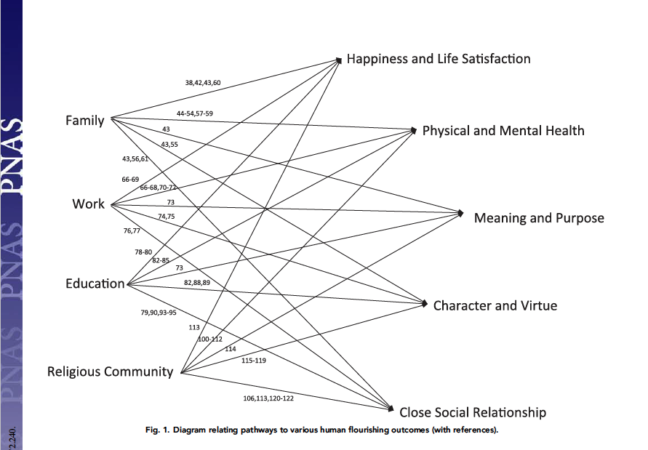
Domains of Human Flourishing
Pathways
Domains

Slide 29
Martin Seligman. PERMA and the building blocks of well-being. J Pos Psychol. 2018;13:333-335
Five elements of the PERMA Model that enable an individual to flourish
Positive emotions
Engagement
Relationships
Meaning
Accomplishment

Slide 31
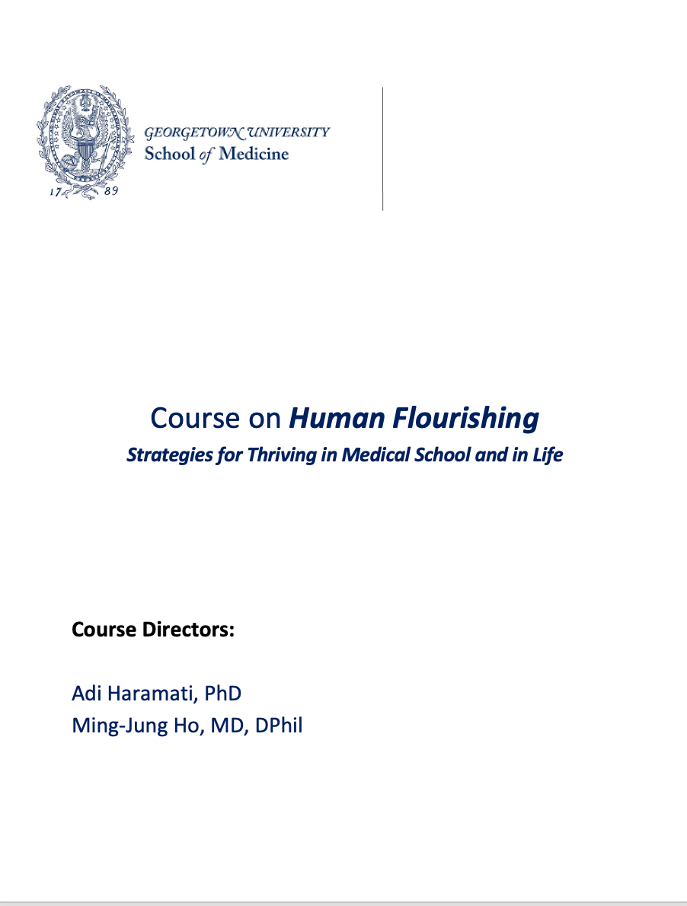
Course Competencies Mapped to School’s Competencies
2. Demonstrate intellectual curiosity and a commitment to learning.
16. Demonstrate independent learning and critically assess the limits of one’s knowledge, skills and values, using a reflective process in the journey of professional identity formation.
19. Maintain personal well-being while balancing the demands of a professional work ethic and commitment to self.

Slide 32
Course on Human Flourishing Strategies for Thriving in Medical School and in Life
Objectives
Describe the concept of Human Flourishing (using the KNN framework and others) and delineate the domains that contribute to Human Flourishing
Articulate how self-awareness and self-compassion are vital for maintaining personal health and well-being and a pathway for addressing 8 domains of Human Flourishing for personal and professional satisfaction.
Develop a plan for thriving during medical training through a commitment to personal growth and self-care

Slide 33
Course in Human Flourishing at Georgetown University SOM
9-week course addresses several HF Domains as Strategies for Thriving in SOM and in Life
Week 1
Self-Awareness
Self-Compassion
Week 2
Happiness, Gratitude and Life Satisfaction
Week 3
Meaning and Purpose
Week 4
Character, Virtue and Values
Week 5
Caring, Empathy and
Kindness
Week 6
Relationships and Family
Week 7
Physical and Mental Health
Week 8
Spirituality and Transcendence
Week 9
Designing your 3-Year Plan for Thriving and Flourishing

Slide 34
Course in Human Flourishing at Georgetown U School of Medicine
Format of groups:
10 students and 2 faculty facilitators per group
Participants (voluntarily sign up for the course) meet once a week for 2 hours for 9 weeks for this “journey of self-discovery”
Structure of Each Session
A safe environment must be created that adheres to certain guidelines
confidentiality, respect, compassionate listening, non-judgment
Check-in (sharing of new reflections and insights)
Introduction of a new domain in Human Flourishing
Process the activity or experiential exercise (sharing insights)
`
1st hour
2nd hour

Slide 35
The course sessions will specifically include activities that foster 4 key pillars (Dahl et al The Plasticity of Well-Being: A Training-Based Framework for the Cultivation of Human Flourishing. Proc Nat Acad Sci USA 117;51:32197–32206, 2020).
Awareness (learning to be present) Connection (strengthening relationships within/across students and faculty groups) Insight (encouraging self-exploration and curiosity) Purpose (providing opportunities and motivation for reflecting on meaning and purpose)

Slide 36
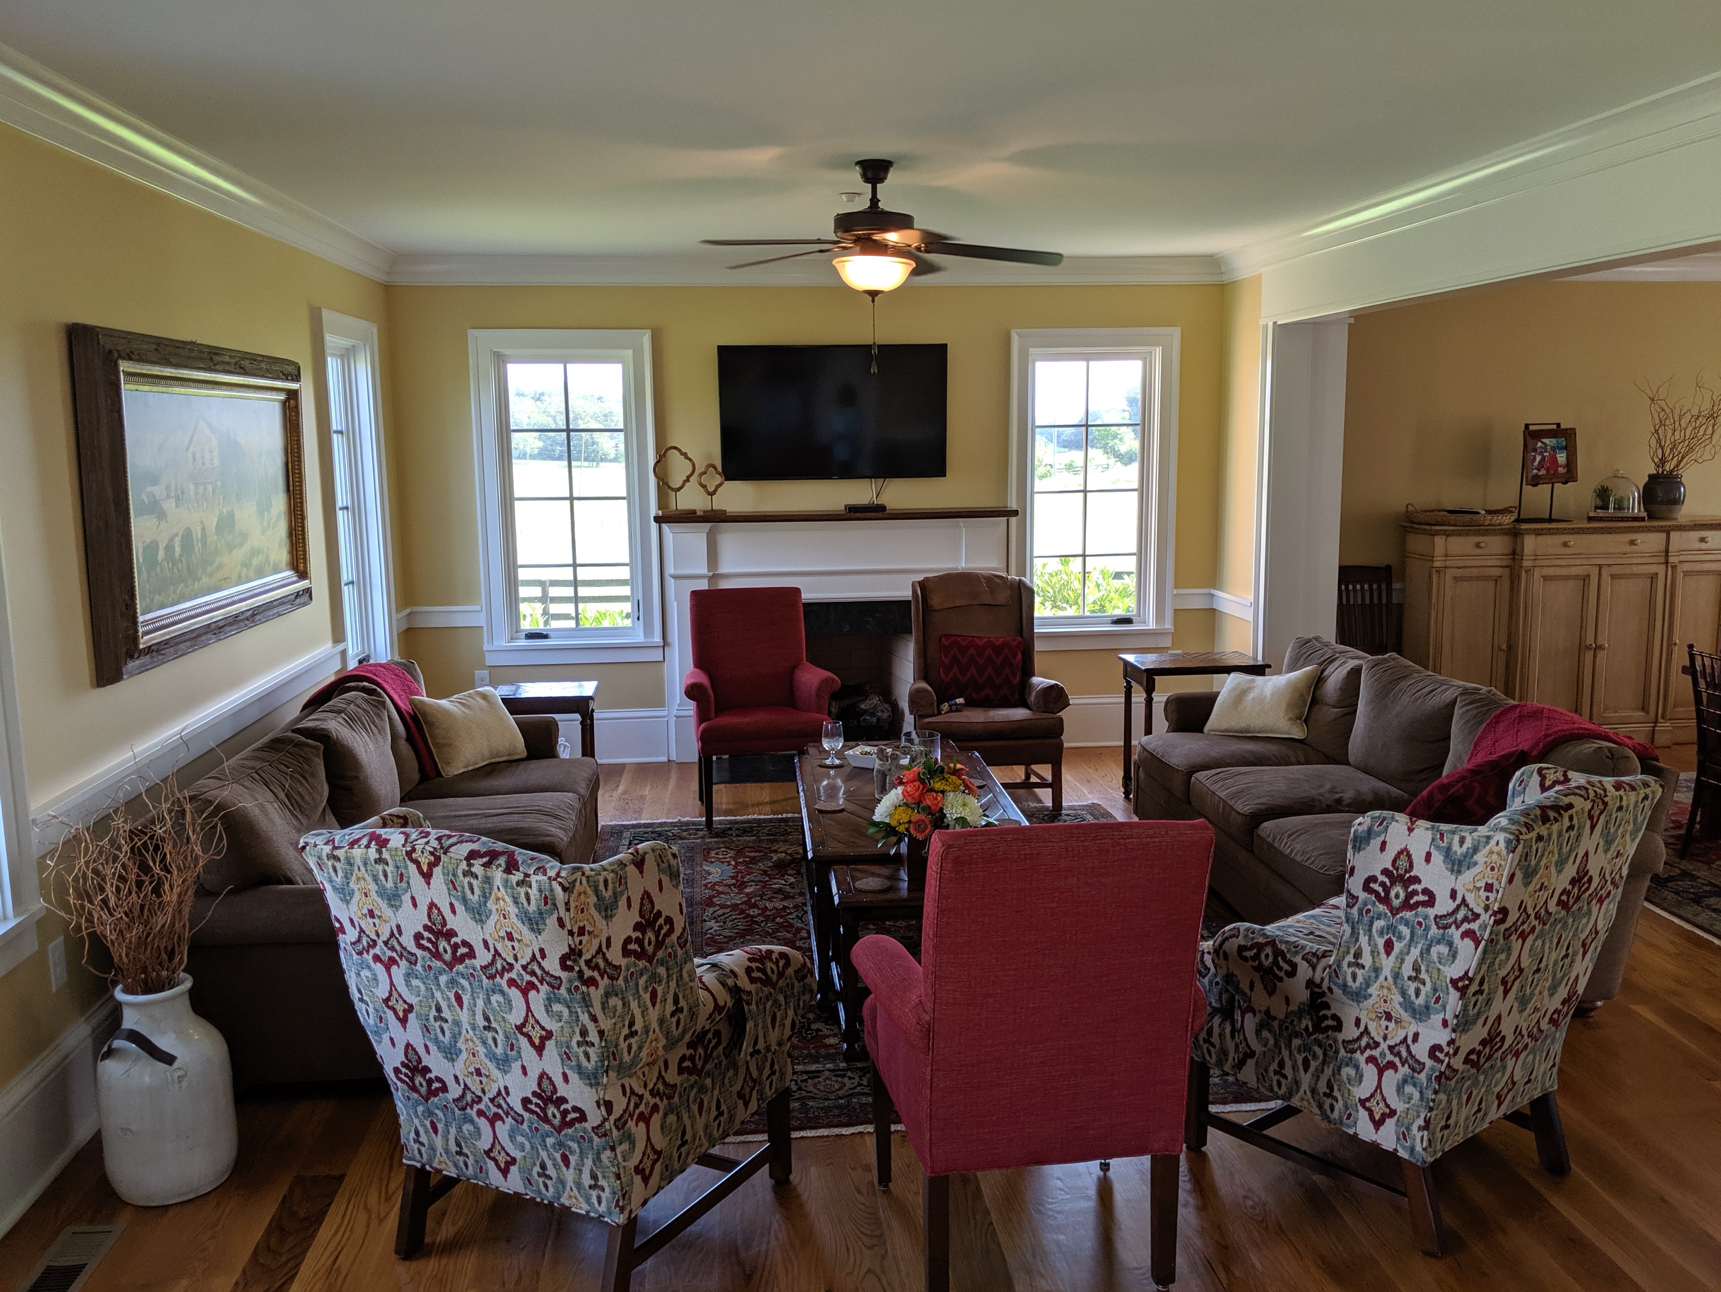
How will we train faculty facilitators?

Slide 37
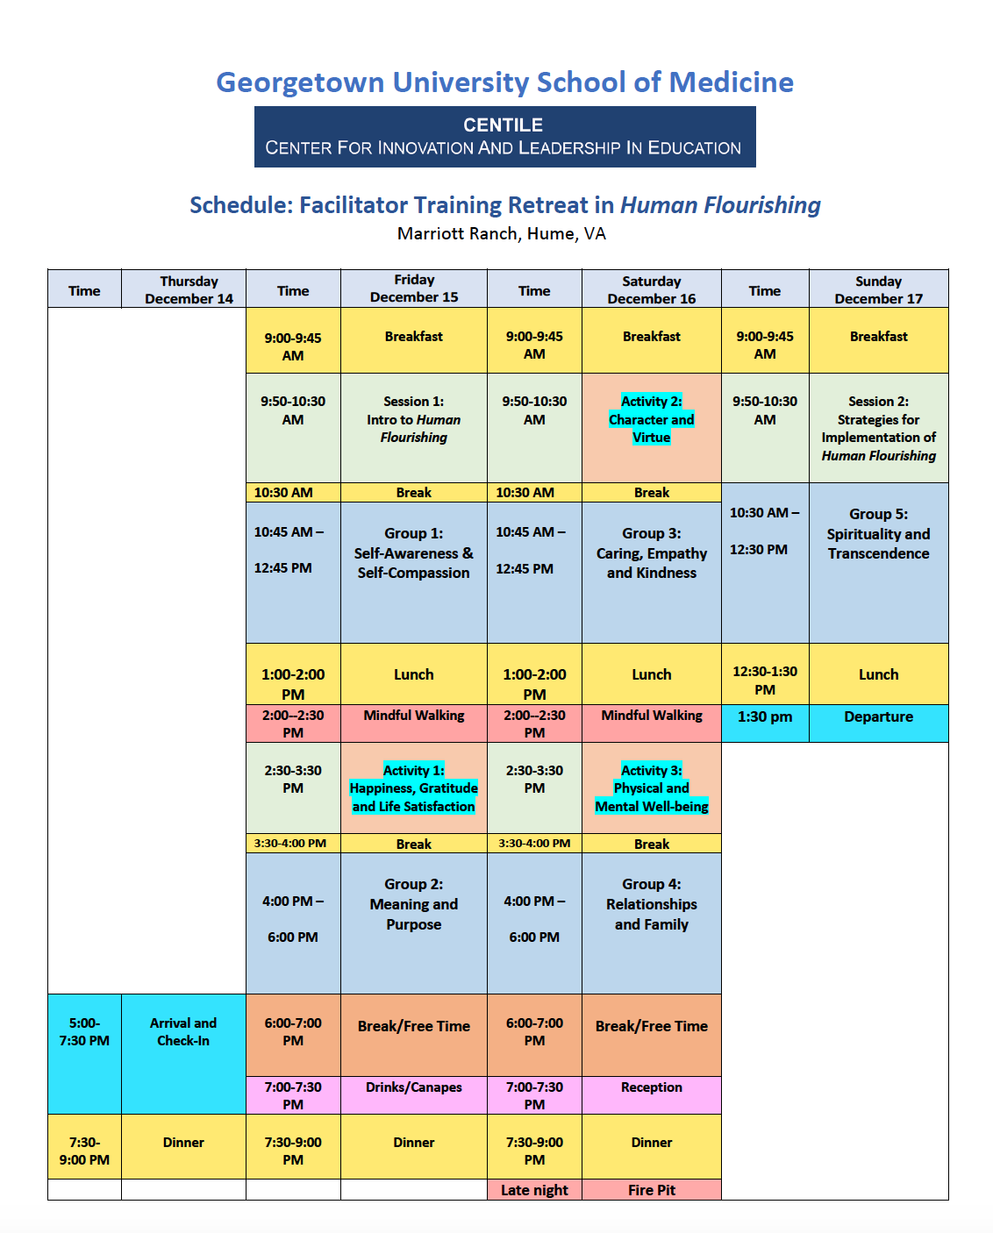
Meals
Discussions on Strategy
Small Group Sessions
Activities
Self-Reflection Time

Slide 38
New Insight
When faculty (esp. interprofessional providers) and senior staff serve as facilitators of both Mind-Body and Human Flourishing groups, they help learners (students and residents) and also help themselves.

Slide 39
Activity

Slide 40
Course in Human Flourishing at Georgetown University SOM
9-week course addresses several HF Domains as Strategies for Thriving in SOM and in Life
Week 1
Self-Awareness
Self-Compassion
Week 2
Happiness, Gratitude and Life Satisfaction
Week 3
Meaning and Purpose
Week 4
Character, Virtue and Values
Week 5
Caring, Empathy and
Kindness
Week 6
Relationships and Family
Week 7
Physical and Mental Health
Week 8
Spirituality and Transcendence
Week 9
Designing your 3-Year Plan for Thriving and Flourishing

Slide 41
What is Self-Compassion?
Dr. Kristen Neff identifies three components of self-compassion:
1) Self-kindness: being kind and understanding to one's self in times of suffering, failure, or when we feel inadequate.
2) Shared humanity: Suffering and being imperfect are part of the shared human experience. Everyone suffers and everyone feels inadequate at times.
3) Mindfulness: Observing our negative thoughts and emotions openly and without judgment, but realizing they are are not facts, just thoughts/emotions.

Slide 42
Question 1:
Think about a time when a friend or family member was going through a hard time or felt bad about themselves.
What did you do in that situation (how did you act, what did you say, what tone did you use)?

Slide 43
Question 2:
Now think about a time when you were struggling or feeling bad.
What did you do in that situation?
(how did you act, what did you say to yourself about the situation, were you self-critical or kind)?

Slide 44
Question 3:
Is there a difference between:
how you treat a friend who is suffering and how you treat yourself?
If so, why?
Think about it for a few minutes and share your thoughts with a colleague

Slide 45
Reflections

Slide 46
Summary
The new course in Human Flourishing aims at fostering self-awareness and explicitly helps students recognize and reflect on 8 domains of their lives to improve their ability to thrive in medical school and in life.
Aligning the competencies and goals of this course with the overall competencies of the school’s curriculum helps address multiple competencies, and provides an important strategy for building institutional buy-in.
Medical educators should consider new and emerging opportunities to meet the needs of learners, and which can also enhance faculty satisfaction.

Slide 47
Take Home Message
Engaging faculty to lead curricular innovations (and model self-care practices) that improve student and resident well-being helps both learners and faculty and contributes to better health and a better learning environment.
Time to Lead with Courage!!!

Slide 48
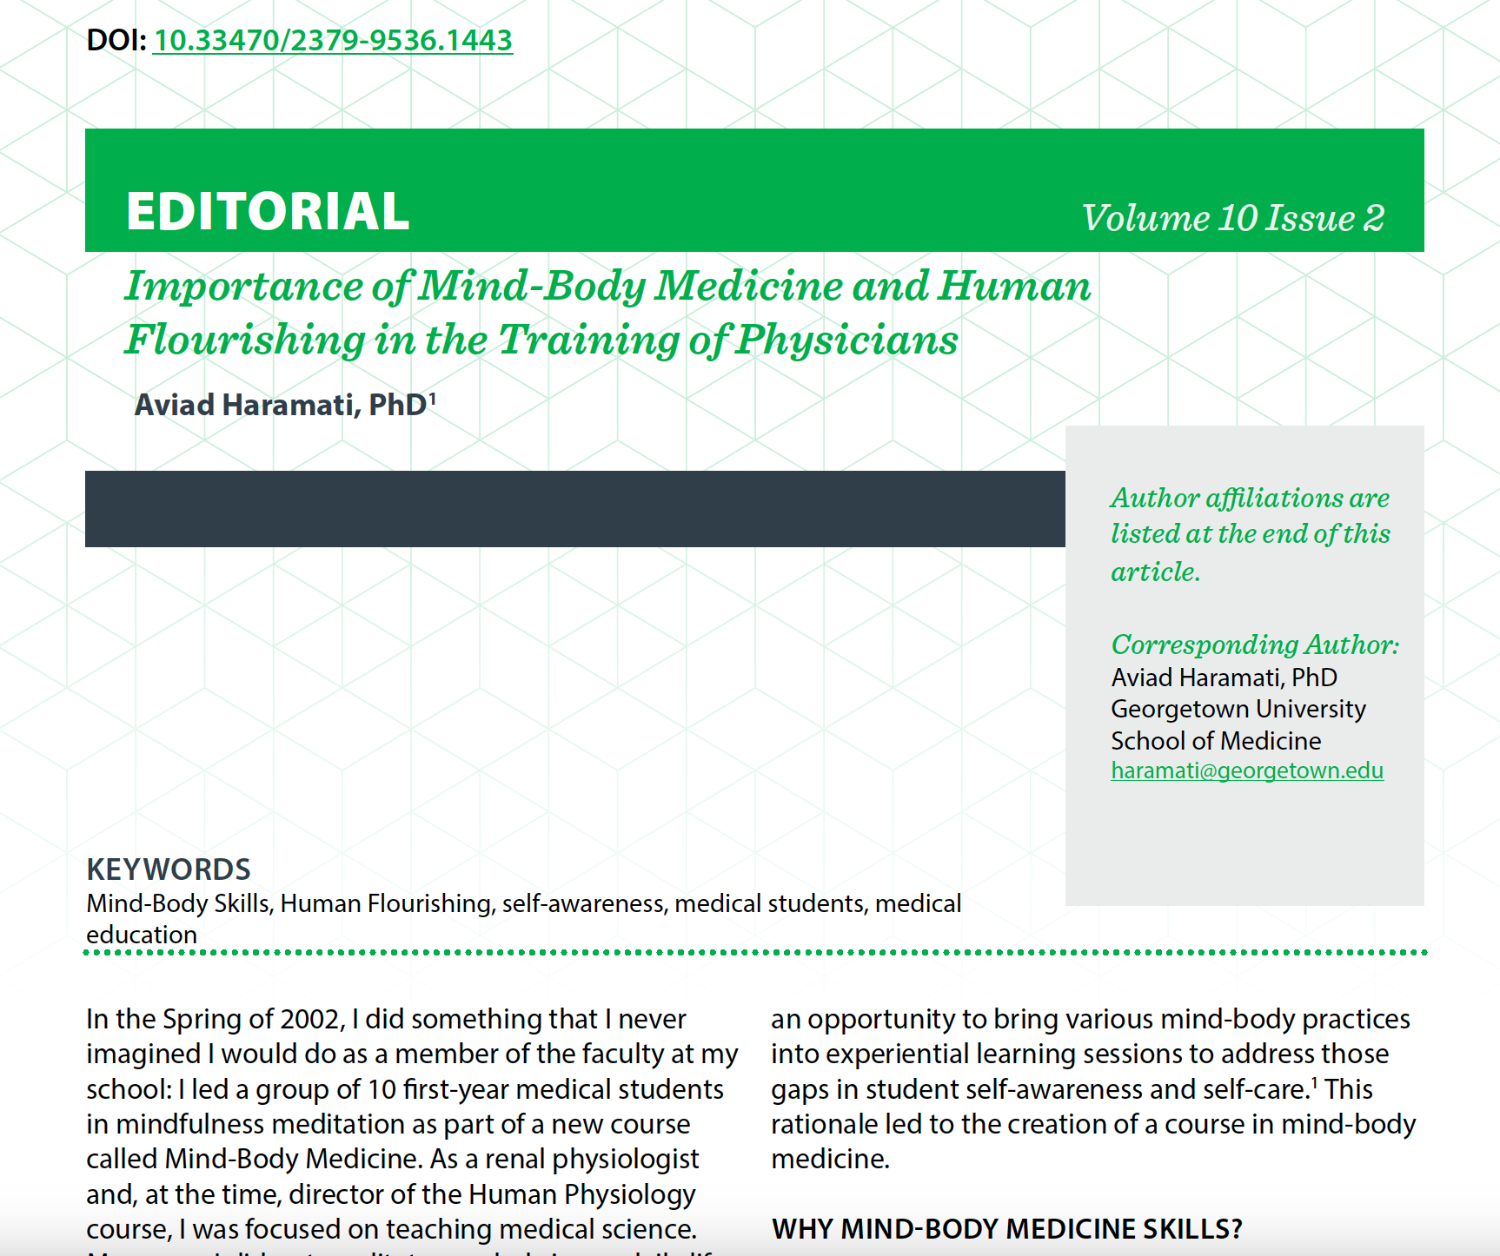
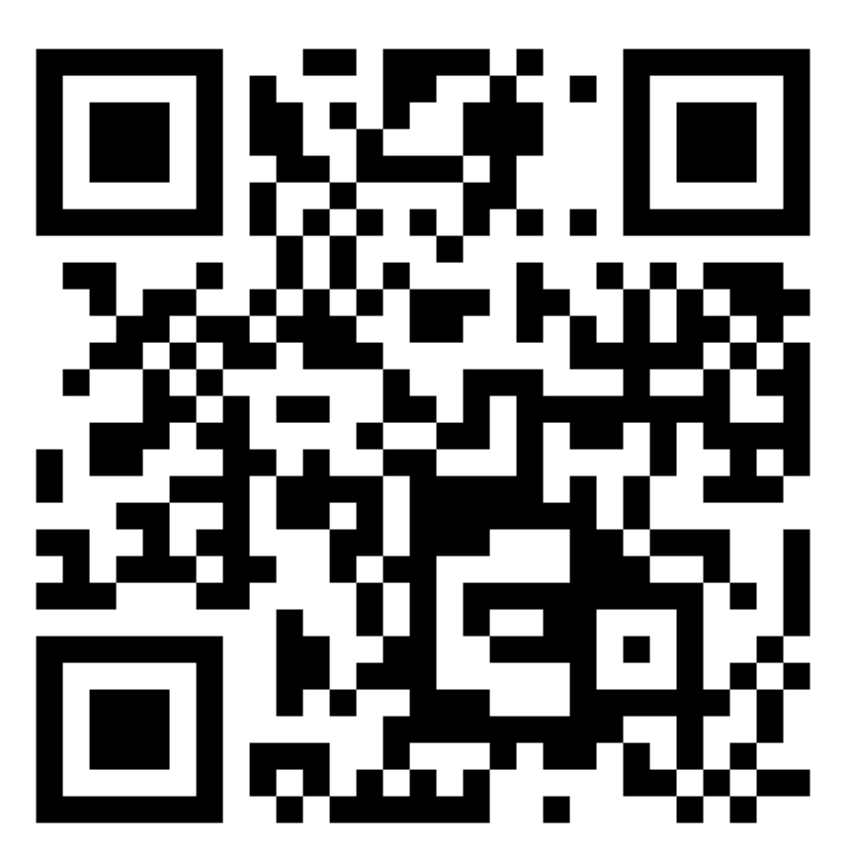
Marshall Journal of Medicine April 2024

Slide 49
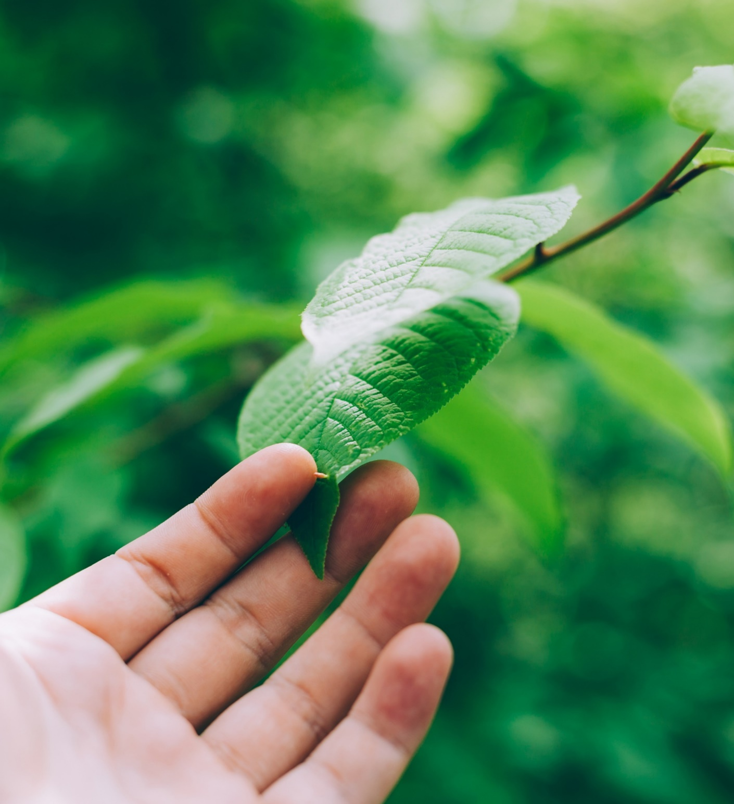
What Will You Do to Cultivate a Culture of Flourishing…
In the next month?
In the next year?

